Slide 1
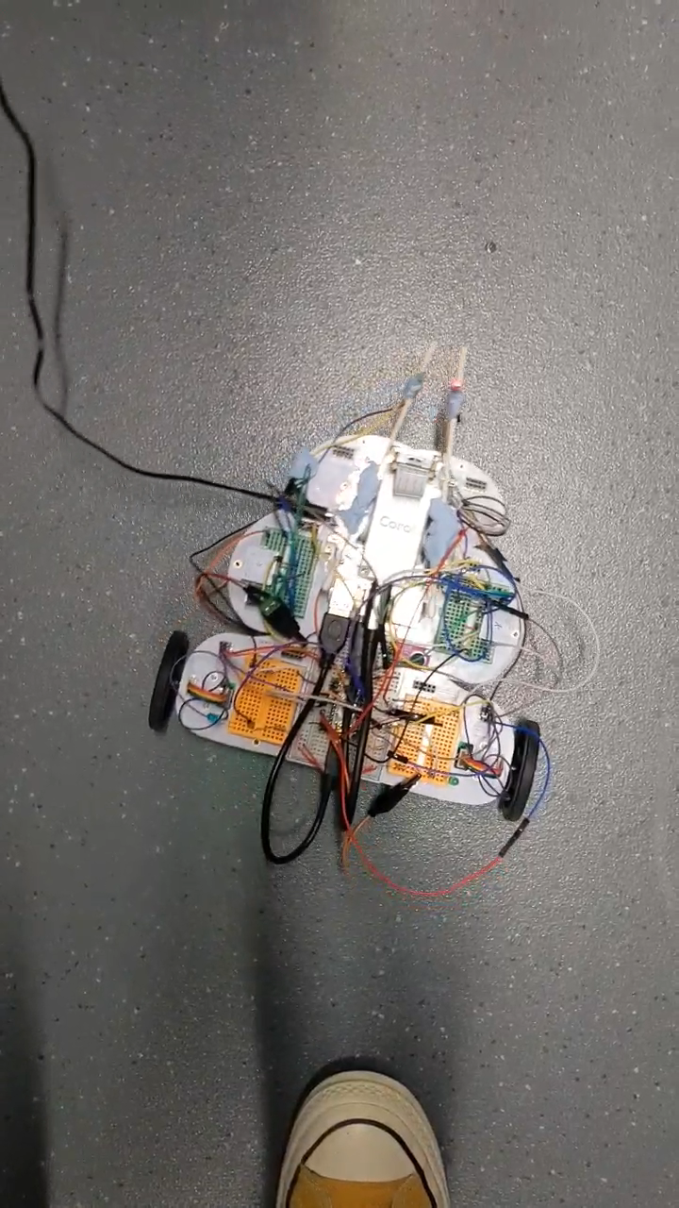
A fully-automated “random walker” (Alex & Yiran)
A randomly generated internal state
Detected by sensory system
Affects motor output
Produces different sensory inputs
Raspberry Pi: randomly generates an internal state according to a fixed probability
Raspberry Pi to Arduino: Either green or red LED is turned on according to the internal state
Raspberry Pi camera: detects and identifies the LED lighting pattern (using ROIs and thresholding )
Raspberry Pi to Arduino: A motion pattern is initiated depending on the detected LED (wheel turning). As a result, the robot performs a random walk.

